Slide 1


Slide 2

BLOOD DONATION CAMP MANAGEMENT SYSTEM USING CODELGNITER
PRESENYED BY : -
2205030201064 : AASTHA SHARMA
2205030201048 : PINKA PATEL
2205030201049 : PRIYANKA PATEL

Slide 3
Blood Bank Management System Project Abstract
The Blood Bank Management System (BBMS) is an application that stores, processes, retrieves, and analyzes data about blood bank administration. It also supervises the blood inventory management and other blood bank-related activities.
The major goal of the blood bank management system is to keep track of blood, donors, blood groups, blood banks, and stock information. It keeps track of all information concerning blood, blood cells, stocks, and blood. Because the project is all done at the administrative level, only the administrator can see it.

Slide 4
Blood Bank Management System Project Modules:
Manage Recipients – The admin has access to the donor management. He can update the blood, can update camp details users, and can view the details of the customer who requested blood.
Manage Donator – The admin has access to the donator of the blood. He can update the details of the donator.
Login and Logout – By default one of the security features of this system is the secure login and logout system. The login and logout system of this Blood Bank Management System uses a session. It means that the user can only log in at once on the same browser.

Slide 5
Blood Bank Management System Project Modules:
Blood Letting Information – For the about us, you will be able see the goals and objectives of blood bank management system.
Donor Registration – For the donor registration, you will fill the forms. Such as your complete name, gender, date of birth, blood type, phone number, email address, home address and etc.
Contact Information – For the contact us, you will be able to see their address, phone number and email address.

Slide 6
UML Diagrams of Blood Bank Management System Project
Entity Relationship Diagram
Use Case Diagram
Data Flow diagram
Activity Diagram
Class Diagram
Sequence diagram

Slide 7
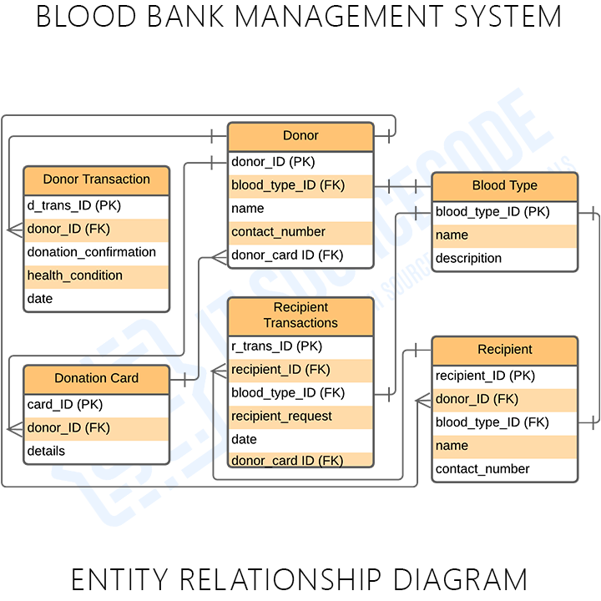
ER (Entity Relationship) Diagram of Blood Bank Management System Project

Slide 8
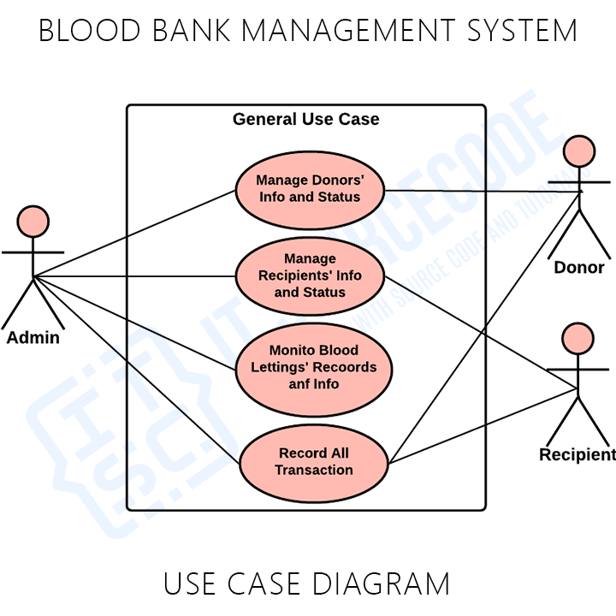
Use Case Diagram

Slide 9
FUNCTIONAL REQUIREMENTS :
ADMINISTRATOR SHOULD HAVE ACCESS TO ALL THE SYSTEM.
FOR THE DONOR PAGE, NAME, ADDRESS, CONTACT/EMAIL AND BLOOD GROUP SHOULD BE MANDATORY.
THE SYSTEM SHALL ENBALE THE NEEDY PERSON TO ADD THEIR BLOOD REQUEST.
THE REQUEST PROCESS MUST BE EASY TO SEND.
THE ADMIN NEEDS TO FORWARD PROPER BLOOD GROUP REQUEST.
THE SYSTEM SHALL ENABLE THE ADMIN TO VIEW, CREATE , EDIT AND DELETE BLOOD CATEGORY AND DESCRIPTIONS.

Slide 10
GOALS AND OBJECTIVES :
TO FACILITATE THE NEEDY PERSON
NEEDY PERSON CAN FIND SAME BLOOD TYPE
EASY TO SEND BLOOD REQUEST.
TO PROVIDE AN EFFICIENT DONORS.
DONOR NEED TO REGISTER HIMSELF.
ONLY SAME BLOOD GROUP DONOR CAN ACCEPT THE REQUEST OF NEEDY PERSON.
NO ONE CAN ACCESS THE PERSONAL INFORMATION’S OF THE DONOR.

Slide 11
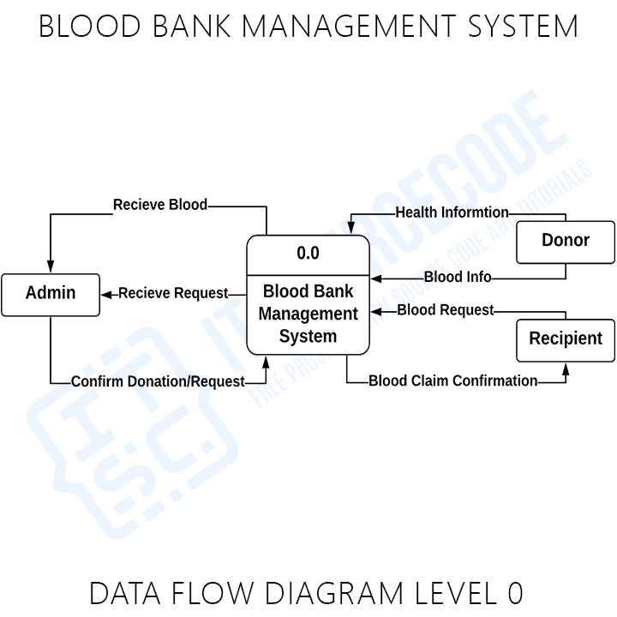
Data Flow Diagram Level 0

Slide 12
FEATURES :
DONOR REGISTRATION :
LOGIN SYSTEM :
DONORS PAGE :
REQUEST FOR BLOOD :
BLOOD REQUEST PAGE :
CONTACT US/SEND QUERIES :
GUIDE LINES:
FAQs PAGE :

Slide 13
TOOLS AND TECHNOLOGIES :
CLIENT SIDE:
Html5
Css3
Bootstrap
JavaScript/Jquery
SERVER SIDE:
PHP
MYSQL

Slide 14
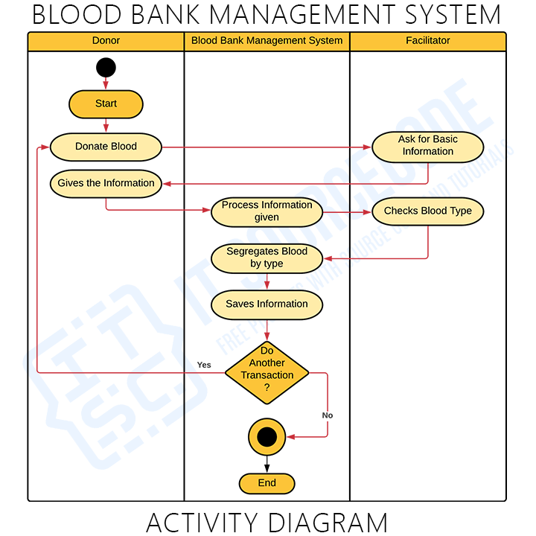
Activity Diagram

Slide 15
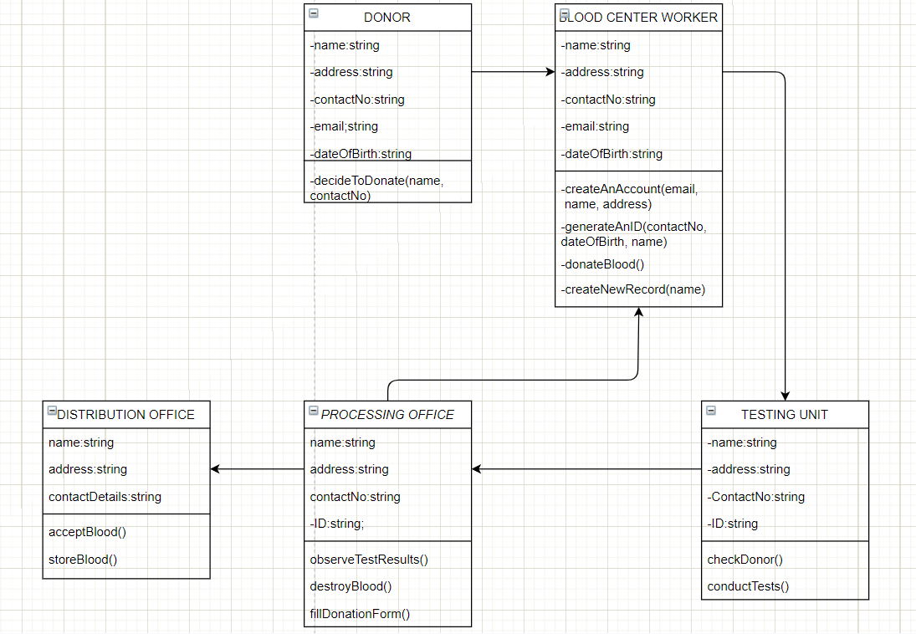
CLASS DIAGRAM :

Slide 16
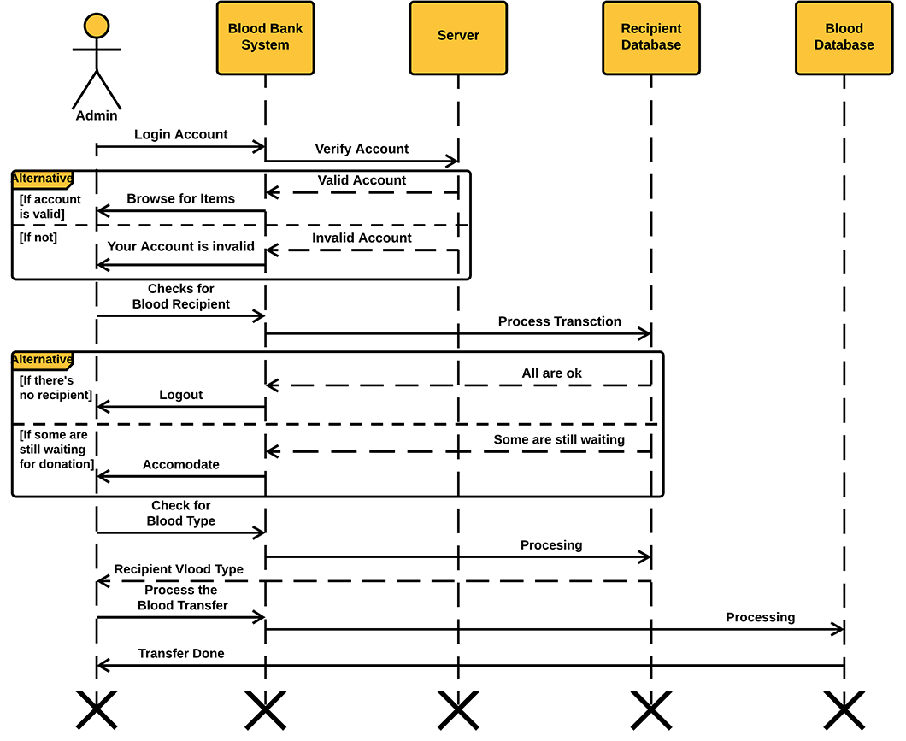
Sequence Diagram

Slide 17
THANK YOU !

